Slide 1


Open Education Menu
Starters: What is possible before a course?
Mains: What can you offer during the course?
1. Set out openness goals at the start of a course
2. Using open (educational) resources
3. Using open textbooks
4. Creating open textbooks
Work on the open science mindset of students:
5. Teaching open ways of working
6. Teaching open and reflexive thinking
Work on the open science skill set of students:
7. Let students practice with reproducibility
8. Let students work with open data
9. Let students work with open-source software
Open Educational Practices:
10. Include interdisciplinary approaches in your teaching
11. Engage in teaching for professionals, beyond academia
12. Engage in teaching for non-professional and lay audiences
13. Have students work on projects with and for society
14. Involve students in creating a course
Desserts: What can you do after a course?
15. Optimising teaching materials for reuse
16. Crediting student work and respecting their copyright
17. Openly share teaching materials
18. Encourage student autonomy in their study trajectory
= effort required compared to not doing it or compared to using traditional/closed approaches

Slide 2
Open Education @UU
Open Learning Opportunities
Open Educational Practices
Open Materials
Community for Open Science in Education (COSiE)
Goals:​
Identify the core Open Science values shared across all disciplines​
Translate this ambition into concrete educational strategies​
March 2026
Funded by: Utrecht Incentive Fund (USO)
Contact information​
​Marie-Louise Goudeau​ (community manager)
m.s.goudeau@uu.nl ​
​Marc van Mil​ (project leader)
m.h.w.vanmil@umcutrecht.nl
Recognition & Rewards
Teaching
Open
Science
Credits: Kernteam Open Science UU

Slide 3
1. Set out openness goals at the start of a course
'In this course we work openly'
How to implement?
Examples
Course descriptions, course manuals, LMS pages or in the oral course introduction you can make explicit why and how (elements) of the course are based on open education principles.
It can include remarks on the role/position of the teacher in this open way of working.
Most practical is to start with a statement on the what: which open practices might students encounter in your course, especially ones that they should reckon with from the start, like using open licensed resources, using open licenses on resources shared, fostering reproducibility in experiments and especially giving students any say in the content or process of the course.
This could lead to a brief Q&A on the why of your open approach. In that advantages at system level (functioning of the science system) could be separated from advantages in the course or project itself (e.g. good RDM and documentation or using free OA and open-source resources) and from advantages for students' expertise and skills that with an open approach might be a better match for future functions in society.
In all this honesty about pros/cons and uncertainties during this transition to open is key.
Life Science & Society Profile of the UU Graduate School of Life Sciences
(Learning) goals
More information
Making OE-elements of the course explicit right from the start helps get students in the right mindset to profit from and contribute to that open approach, especially if it implies a new or unfamiliar way of working for students.
Toolbox Inclusive Teaching UU

Slide 4
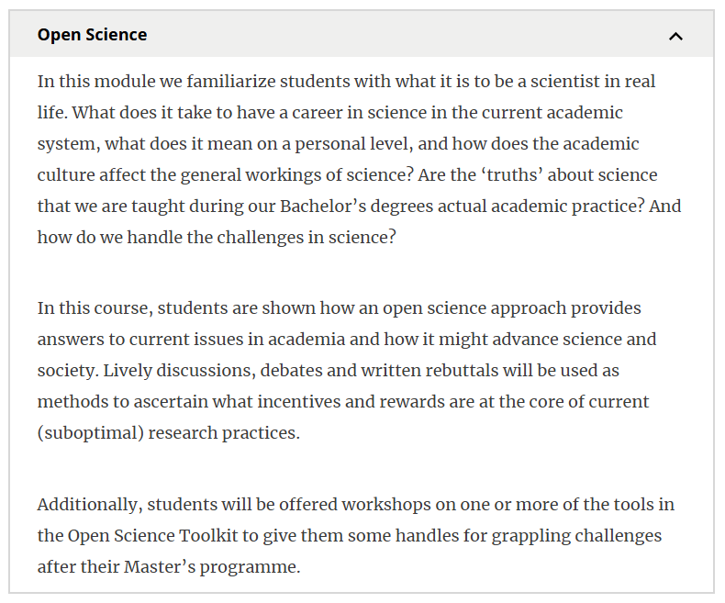
Set out openness goals at the start of a course
Life Sciences and Society profile GSLS
Open Science subjects that are discussed during the course
The methods used to teach these subjects during the course
Which tools are students given to continue using their knowledge after the course?

Slide 5
2. Using open (educational) resources
There are many different open resources available!
How to implement?
Examples
Start by identifying suitable open resources. To properly integrate the material in your course, you can pay attention to the following:
Does the material align with the course learning objectives?
Is the material clearly licensed with an open license (e.g. Creative Commons)? Always properly attribute the original authors and make sure the material can be freely reused, adapted and redistributed.
Is the material up to date and of sufficient quality?
Extra’s
To make this course more ‘spicy’, you can adapt the material to fit your specific educational context better.
Align resources with learning objectives
Adjust the level to your students
Contextualize with discipline-specific cases
Combine and remix multiple open resources
AI-Literacy modules UU are based on AI-Literacy modules GSLS.
Open access journals:
openjournals.nl
Open (educational) resources (OER) offer a wide variety of materials, such as textbooks, articles, slides or exercises, that are openly licensed and freely accessible. These sources can be (re)used, adapted and shared.
(Learning) goals
More information
Increased accessibility of learning materials for students.
Reuse, adaptation and continuous improvement of teaching materials
Utrecht University Library - Open Educational Resources

Slide 6
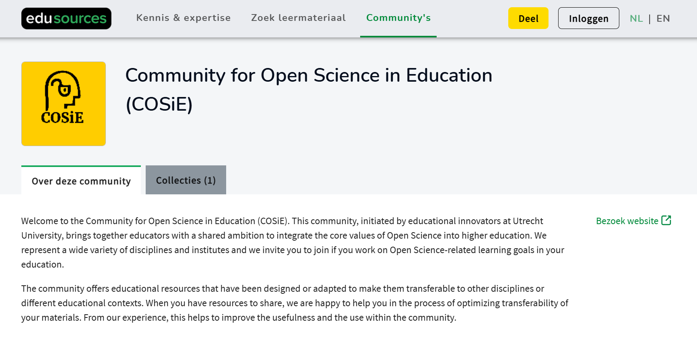
Using open (educational) resources – Edusources.nl
Open educational resources on edusources.nl
(Re)use open educational resources
Search for educational materials
Share your own materials
Examples on how to use open resources in practice

Slide 7
3. Using open textbooks
Working with open textbooks
How to implement?
Examples
An open textbook is a textbook that freely accessible to everyone, written by experts in the field. These textbooks have an open license and can thus be used and modified, increasing collaboration and promoting high quality educational resources. They can be classic, but also more innovative, dynamic or interactive. They can have an editable format.
This is something you likely consider when setting up a new course or when you want to switch textbooks anyway.
You can search for textbooks in online libraries like Open Textbook Library, LibreText, OER Commons, MERLOT, or OpenStax. Edusources lists many open textbooks from Dutch HE institutions.
Additionally, colleagues or librarians can help in your search or might already have some recommendations!
Check the sustainability of the open textbook: what is the license, is it dynamically updated, are there stable versions, can it be downloaded?
Chef’s Tip:
Ask the COSiE Community or the UU library for help on finding open textbooks!
A few good examples are Environmental Toxicology, The European Experience and Quantitative Methods and Statistics.
(Learning) goals
More information
Increase affordability to students
Increase collaboration and expansion of educational text/works
Support the transition to open textbooks
Up-to-date information
Utrecht University Library - Open Educational Resources
RUG - Open textbook links

Slide 8
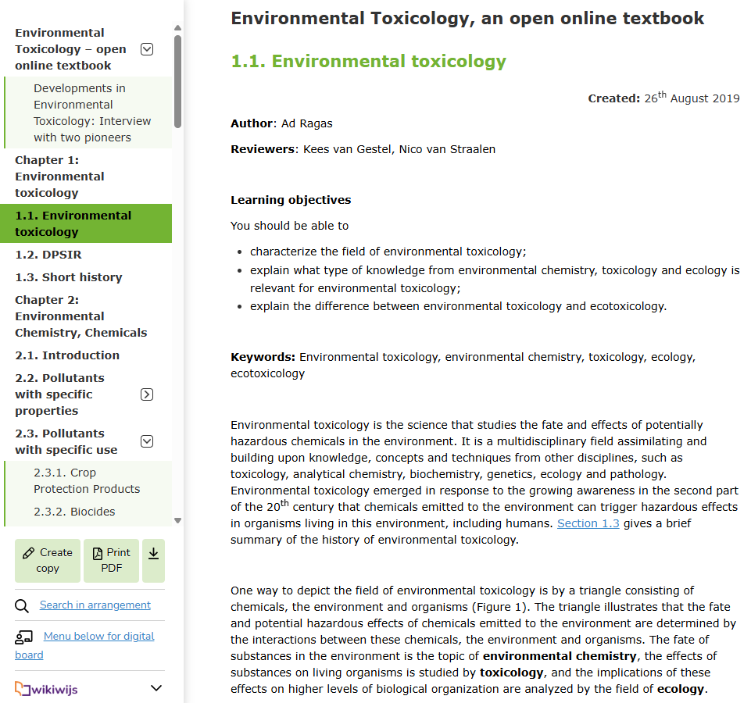
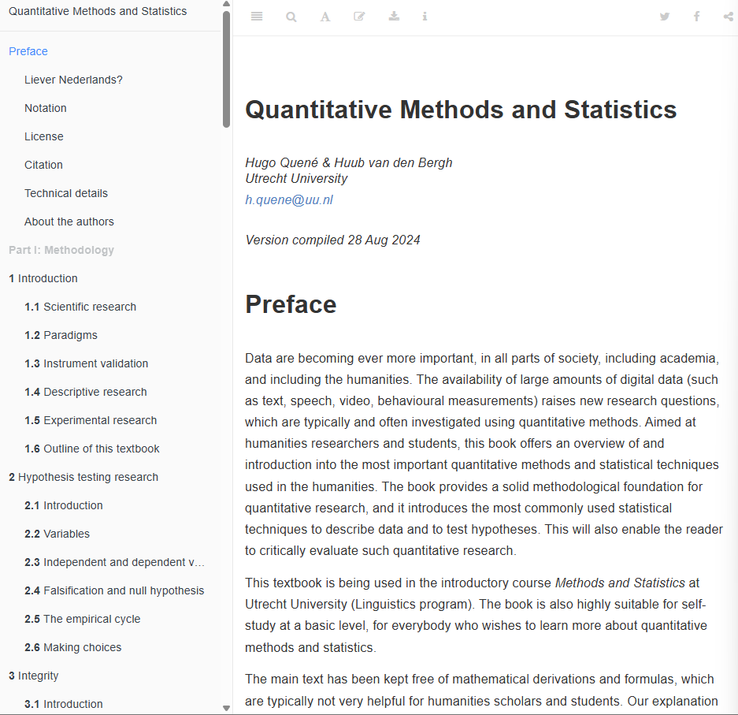
Using open textbooks – What do they look like?
Examples of Open Textbooks on different platforms
Environmental Toxicology (Wikiwijs)
Quantitative Methods and Statistics (GitHub)

Slide 9
4. Creating open textbooks
Creating an open textbook
How to implement?
Examples
Open textbooks are freely accessible to everyone, written by experts in the field. These textbooks have an open license and can thus be used and modified, increasing collaboration and promoting high quality educational resources. They can be classic, but also more innovative, dynamic, interactive. They can have an editable format.
There are various ways of creating or contributing to an open textbook: from scratch, based on a tried and tested syllabus, adding to an existing open textbook or reformatting a (closed) textbook that you have the full copyright and necessary exploitation rights of. Simply publishing a classic textbook open access is also helpful.
Creating a full open textbook from scratch requires a lot of effort, like any textbook, but perhaps even more because ideally you want to build on the openness advantage by making it dynamic and perhaps even interactive, with online assignments. The task could become more manageable by making it a collaborative project.
The library can advise on platforms and publishers that are suitable for creating, publishing and hosting open textbooks.
Environmental Toxicology, The European Experience and Quantitative Methods and Statistics.
See this meeting report on open textbooks
(Learning) goals
More information
Increase affordability to students
Increase collaboration and expansion of educational text/works
Increase efficiency in creating education (not duplicating efforts)
Up-to-date information
Edusources guide: How to make an open textbook
UU Library OER support
RUG – Open textbook links

Slide 10
Creating open textbooks – How does that look?
Examples of Open Textbooks on different platforms
Environmental Toxicology (Wikiwijs)
Quantitative Methods and Statistics (GitHub)

Slide 11
5. Mindset: Teaching open ways of working
Open ways of working
How to implement?
Examples
To be able to practice Open Science effectively, students not only need to know how to practice Open Science, but also why Open Science matters.
Open ways of working is about sharing and reusing, involving all relevant parties. It includes notions on transparency, reproducibility, collaboration, inclusivity and integrity.
Implementation of any practice, big and small, into coursework contributes to creating an open science mindset, but above all the actual sharing, reusing and engagement practices. Let students discuss and reflect on those practices. Help them to explicitly weigh underlying values to decide when, why and how to use Open Science practices to help improve science and scholarship.
Show that science is the result of individuals working in teams, building on and contributing to a global endeavour. For example, by documenting their decision processes: it improves their process and is essential for others to build on their work. Probe students’ reflection by helping them ask critical questions about the academic system, scientific knowledge, and practices.
Try not to treat open science as a set of rules, instead focus on open science as good practices, shared values and shared aspirations to make science and scholarship valuable for society.
Workshop:
The Faces of Open Science
The course Open Science for Physicists has been created using the open mindset idea
(Learning) goals
More information
Let students experience working openly around shared resources. The goal is to reflect on their way of working and help them realize that open approaches likely constitute the most obvious, productive and motivating way of working during their courses, as well as providing essential skills and disposition for their professional careers.
Interview with Thomas Rhys Evans on open science mindset (FORRT)

Slide 12
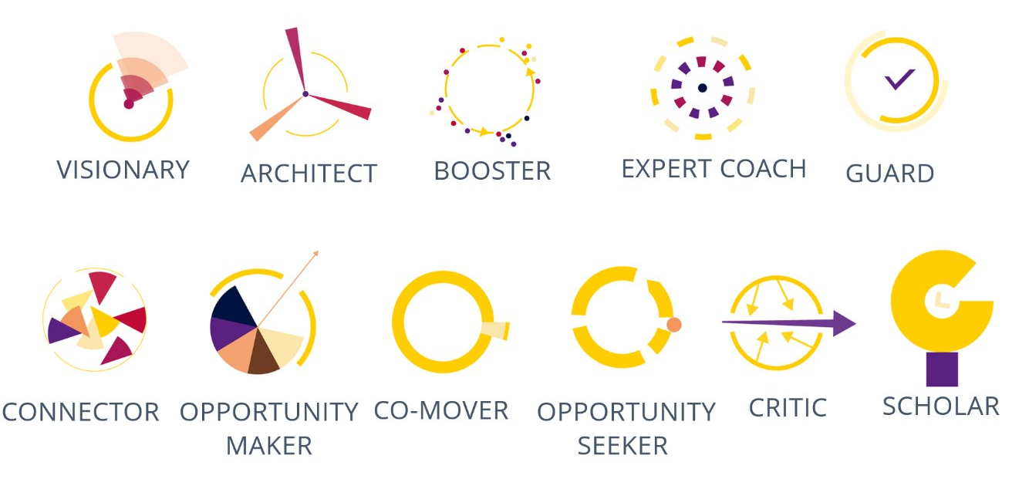
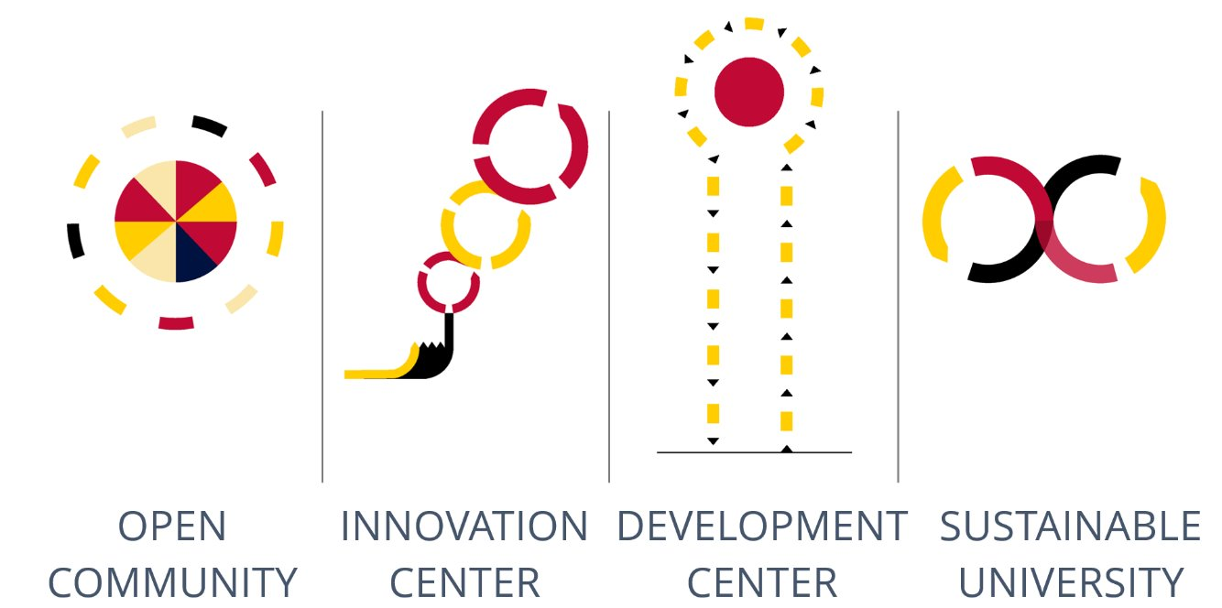
Mindset: Teaching open ways of working
Workshop: Faces of Open Science
Eleven Personae
Participants explore the different perspectives within the Open Science movement.​
Broad target audience: ​
Bachelor, graduate and PhD students​
Academic and support staff​
Educators, trainers and curriculum developers​
The diversity of the Open Science community is visualized through the Eleven Personae and Four Ideal Academies within the Open Science community.
Four Ideal Academies

Slide 13
6. Mindset: Teaching open and reflexive thinking
Open and reflexive thinking
How to implement?
Examples
Students not only need to know how to practice Open Science, but also why it matters. Open and reflexive thinking refers to students’ and teachers’ (self-) critical attitude towards the academic system and scientific knowledge. It involves weighing values like quality, integrity, collective benefit, equity, fairness, diversity and inclusiveness.
Introduce the underlying values of Open Science (for example with the UNESCO Recommendation) and relate these to current problems in academia. Help students to explicitly weigh values to decide when, why and how to use Open Science practices to help improve science and scholarship.
Try not to treat open science as a set of rules or fixed guidelines, instead focus on open science as good practices, shared values and shared aspirations to make science and scholarship valuable for society.
Give examples of complex decisions from your own practice. For example, the decision to make pseudonymized data openly available: To which extent do data need to be pseudonymized? And with strict pseudonymization, are data still valuable or too de-contextualized to have meaning? Or discuss how to balance spending public money on particularly time-consuming Open Science processes and the extent to which they add value.
Workshop:
The Faces of Open Science
Using the UNESCO Recommendation on Open Science for underlying values and principles.
Learning goals
More information
Understanding the values, principles, and methods of Open Science.
Developing a vision on causes of and solutions to academic issues and the role of Open Science practices.
Weighing different values, principles, and pragmatic choices to come to a decision on when, why and how to use Open Science practices.
Interview with Thomas Rhys Evans on open science mindset (FORRT)
UU manifest about Open Science mindset.

Slide 14
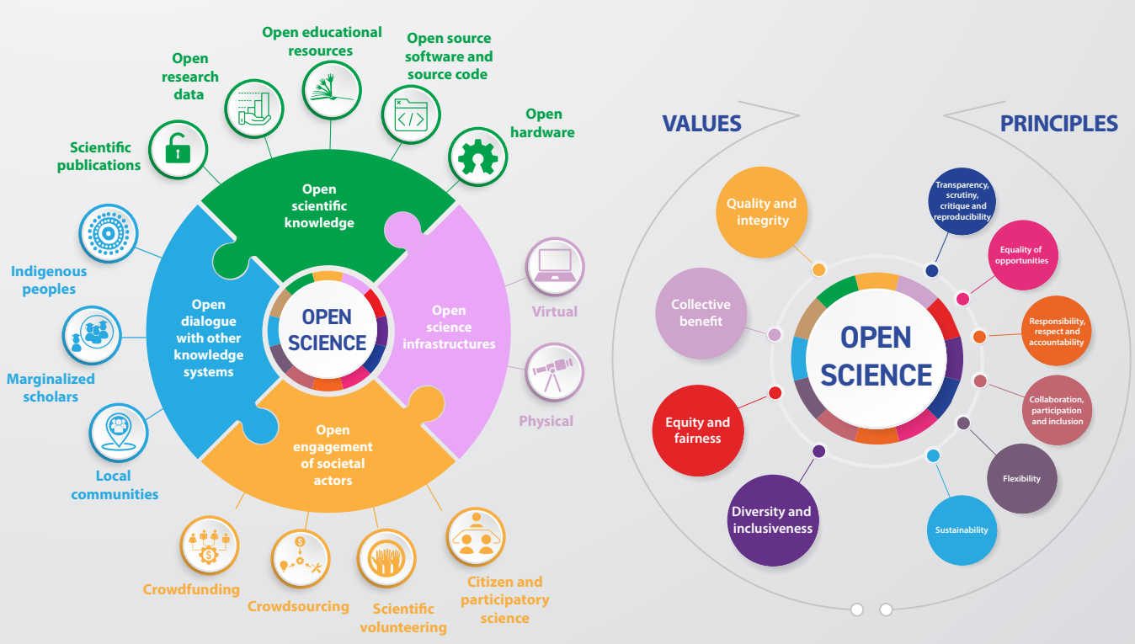
Mindset: Teaching open and reflexive thinking
Practices
&
skills
Mindset
Assignment: Stick coloured stickers on a set of Open Science practices corresponding to the UNESCO value
Quality and Integrity | Respect academic freedom & human rights High-quality research Rigorous review and scrutiny Transparent evaluation
Collective benefit | Science belongs to humanity Benefit humanity as a whole Inclusive and equitable Sustainable Equal opportunities for science education
Equity and fairness | Fair & reciprocal sharing of inputs & outputs Equal access to scientific knowledge (producers & consumers)
Diversity and inclusiveness | Diversity of knowledge, practices, workflows, languages, outputs, topics Support epistemic pluralism in scientific community & wider public & other knowledge holders (e.g., indigenous people, local communities, social actors)
Print out as many Open Science practices as possible
https://tinyurl.com/os-workshop-practices
openly setting priorities
sharing proposals
commenting openly
pre-registering
sharing
data
sharing code & using open software
sharing notebooks
collaborative writing
sharing preprints
using open & post-pub PR
claiming credit for peer review
publishing open access

Slide 15
7. Skills: Let students practice with reproducibility
Reproducibility
How to implement?
Examples
Reproducibility is the cornerstone of sound research. We show where our knowledge comes from in a manner that enables others to check and replicate. Reproducibility and transparency, therefore, go hand in hand. This makes reproducibility a perfect pedagogical tool to teach the how and why of open science practices.
Transparency about how research was done and what claims are founded on, are crucial elements of sound research in all academic fields—regardless of whether they use the term reproducibility or not. Practicing with repeating existing research in an educational setting means putting this transparency to the test.
Depart in your teaching activity from "real" research: published, peer reviewed work. Ask students to try and make sense of where results or claims are based on by redoing parts of that research. Depending of the field this can mean things like
Repeating a statistical analysis
Rebuilding a graph
Dissecting an argument
Retracing claims through referenced sources
This activity is scalable – from one lesson to an entire course – and open to both disciplinary and interdisciplinary settings.
LEGO® Metadata for Reproducibility game pack
(Learning) goals
More information
By reproducing existing research, students gain an understanding of
the manners in which researchers uphold the methodological norms of their academic field
the extent to which these practices are transparent and reproducible
the opportunities and limits of reproducibility and open science
NL Reproducibility Network

Slide 16
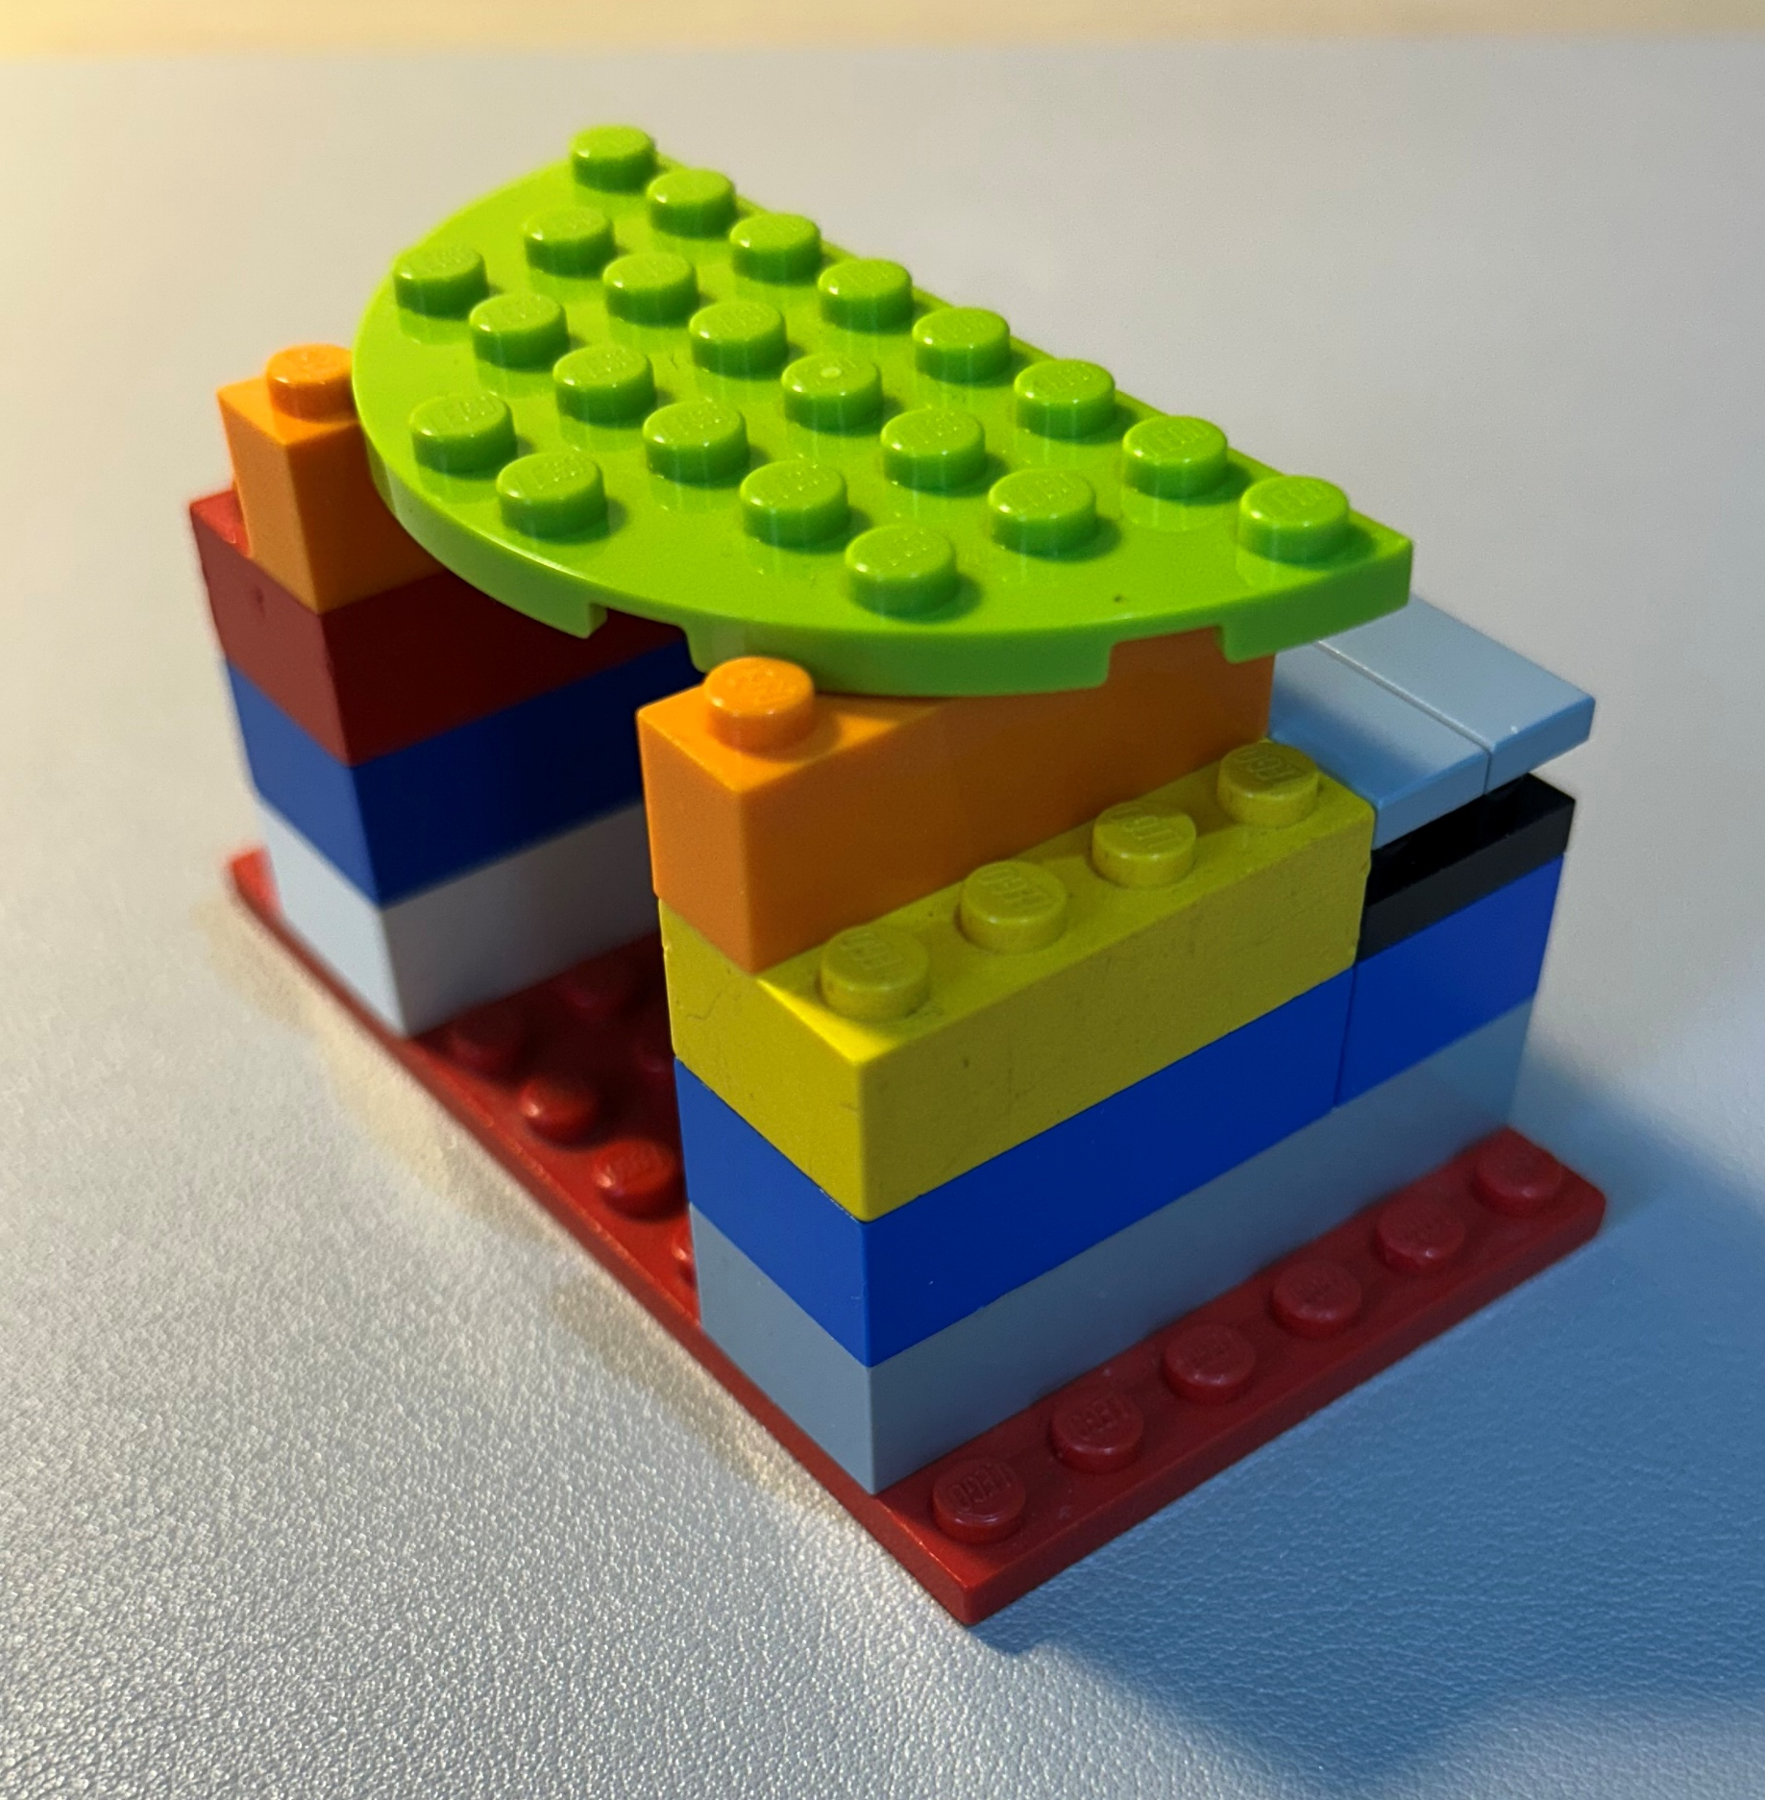
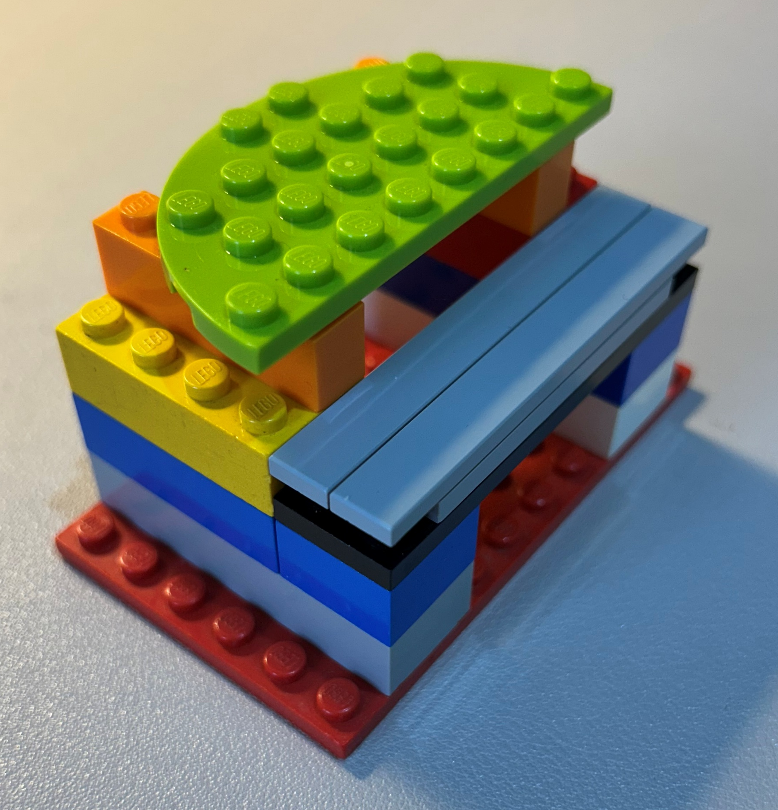
Skills: Let students practice with reproducibility
LEGO® Reproducibility Game (Methodological transparency)
Learning goals:
The importance of methodological transparency
What does “Methodological transparency” mean, how can it be achieved, and what are its limits?
Round 1: Building (10-15 min)
Students receive a random set of LEGO® pieces and are asked to build something.
They document the building procedure in any way they like:
Written text
Images
Combinations of both
Etc.
Groups are not allowed to see what the other groups have built. Afterwards, the instructor photographs the constructions.
Round 2: Reconstruction (10-15 min)
The groups switch places and try to rebuild each other’s constructions with the instructions they are given, within a fixed amount of time.
Round 3: Discussion
The original and reconstructed models are shown side-by-side and the group compares them. The group discusses the quality of the reproductions in relation to the instructions.
This exercise takes its inspiration from
Donaldson, M. and Mahon, M. (2019); LEGO® Metadata for Reproducibility. University of Glasgow. DOI: http://dx.doi.org/10.36399/gla.pubs.196477

Slide 17
8. Skills: Let students work with open data
Working with open data
How to implement?
Examples
Within a course, you can let students work with open data (numerical, statistical, but also textual, audio or visual data). Open data has an open license and can be freely accessed, (re)used and shared. Students learn about transparency and reproducibility. Open data can be presented and processed in whatever way you like.
(1) Open data sources
Open datasets can be obtained from public research repositories, government and policy data portals or choose datasets accompanying scientific publications.
Always check the license to be sure you know how you can (re)use the data.
(2) Considerations: Data quality and complexity
The quality, structure and complexity of datasets vary widely. Not all datasets will align with the learning objectives and level of the course. The advantage of open data is that you can reformat, restructure, clean or combine data sets to optimise them for educational use.
(3) Discussion points
Open licenses
Potential biases or limitations in the dataset
Data sources and documentation
Many example datasets in teaching are open data already.
Applied Data Science course using open data
(Learning) goals
More information
Familiarize students with real research data, open governmental data or open official statistical data
Allow easier sharing of products created during courses
Introduce principles of transparency, reuse and reproducibility
Students learn about the ethical, legal and societal aspects of data sharing
The UU has a guide on finding existing data.
Article: Pedagogy of teaching with large datasets

Slide 18
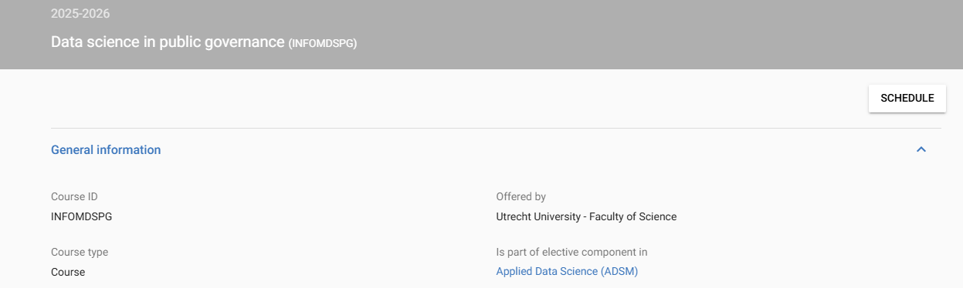
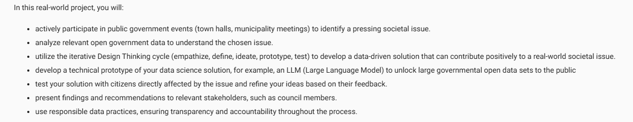
Let students work with open data
Data science in public governance
https://osiris-student.uu.nl/onderwijscatalogus/extern/cursus?cursuscode=INFOMDSPG&taal=en&collegejaar=huidig

Slide 19
9. Skills: Let students work with open source software
Working with open source software
How to implement?
Examples
Open source software is freely accessible and transparent. By using open source software, students can be taught the importance of reproducibility in research and open collaboration. After the course, students can continue using the software without license barriers.
(1) Select appropriate open source software
Choosing the right software can be challenging. It is important to consider that the software:
Aligns with the course learning objectives
Is technically reliable: stable or actively maintained
Is well-documented and has clear tutorials
Examples of open source software are:
R, Python, JASP (data analysis)
Zotero (reference management and sharing resources)
Git (with GitHub, GitLab or Codeberg; version control)
ASReview (scanning large numbers abstracts/texts)
ggplot2, matplotlib (R&Pythonpackages for visualization)
(2) Integrate open source software into the course
Embed the use of open source software into learning activities, such as data analysis assignments (R or Python) or group work using Git-based collaboration.
(3) Introduce students to the importance of open source software and open science
Explain why open source software is being used: transparency, reproducibility, accessibility.
Many courses have migrated to open source software, such as the use of JASP instead of SPSS in Methodology & Statistics courses. See e.g. https://www.uu.nl/en/news/jasp-is-very-well-suited-to-the-open-science-era
(Learning) goals
More information
Familiarize students with commonly used tools in open and reproducible research
Less dependence on paid or institution-specific software licenses; students can also use the developed skills beyond academia.
Introduce students to open science values
UU Knowledge Centre FAQ FAIR Data and Software

Slide 20
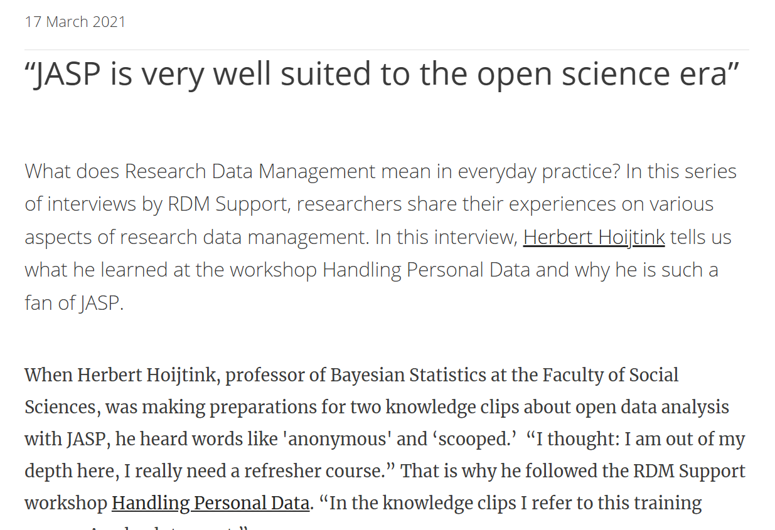
Skills: Let students work with open source software
Using Python instead of Stella as programming software
JASP instead of SPSS in methodology & statistics courses
Stella
Proprietary software (‘closed’)
License costs and limited access
Limited transparency
Python
Open source and freely available
Large community and extensive documentation
Code is fully visible, making the models transparent
Analyses are reproducible
https://www.uu.nl/en/news/jasp-is-very-well-suited-to-the-open-science-era

Slide 21
10. Include interdisciplinary approaches in your teaching
Learning from other perspectives
How to implement?
Examples
Interdisciplinary teaching includes integrating perspectives, methods or knowledge from multiple disciplines within a course. This helps students develop a better understanding of complex problems and collaborate across different fields.
Important questions to consider when implementing interdisciplinary approaches are: ‘Why do you want to include interdisciplinary elements into your course?’ and ‘How could interdisciplinarity serve the learning goals of your course?’
The UU created a four-stage model for interdisciplinary learning:
Disciplinary grounding
Perspective taking
Finding common ground
Integrating perspectives
Depending on the stage your students are in, you can adapt the learning activities suitable for this group.
Concrete ideas:
Guest lectures from different disciplines
Working together with students from other disciplines
Involve data from another field into a project
UU collection Interdisciplinary teaching on Edusources
(Learning) goals
More information
Interdisciplinary approaches help students to:
Gain insight in multiple perspectives on a topic.
Be prepared for complex, real-world problems.
Reflect on assumptions and methods in their own field.
UU Four-stage model for interdisciplinary learning

Slide 22
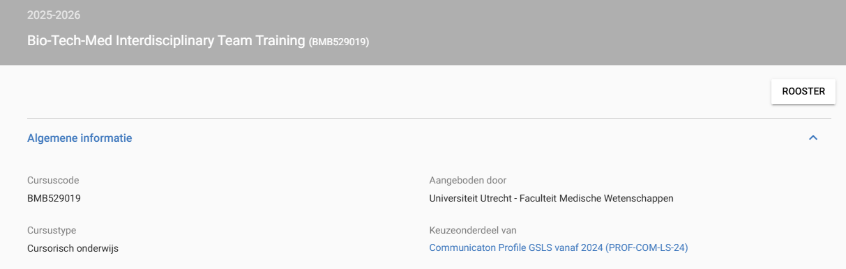
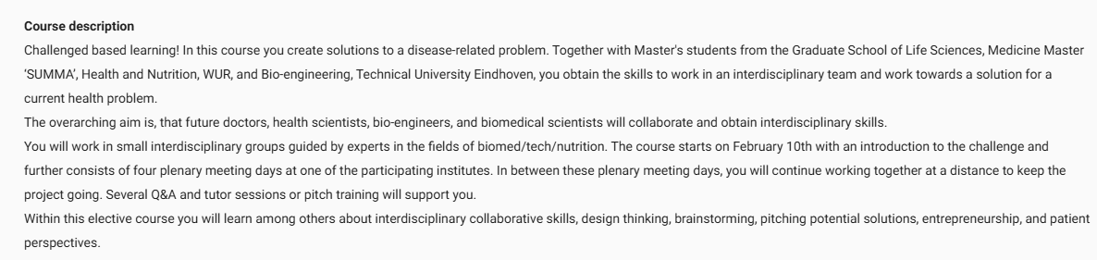
Include interdisciplinary approaches in your teaching
Bio-Tech-Med Interdisciplinary Team Training (GSLS Communication profile)

Slide 23
11. Engage in teaching for professionals, beyond academia
Teaching beyond academia
How to implement?
Examples
Open education can mean opening up our education to different audiences than students. For example:
Post-graduate education, such as Summer Schools
Continuing Education, such as courses with rolling enrolment (‘Open program’) or in-company training.
Consultancy
Any existing course may be opened up as education for professionals. Two popular strategies are to convert the materials into a Summer School (or Winter School, or Small Private Online Course ‘SPOC’) or to be offered as Continuing Education.
Continuing Education can be developed as an open program where participants sign up individually or, at an organization's request, as a customized in-company offering. In developing and delivering Continuing Education, there are four key steps: 1) plan, 2) produce, 3) run, and 4) evaluate. The full step-by-step plan can be found on the UU Intranet: https://intranet.uu.nl/en/continuing-education/developing-continuing-education/step-by-step-plan-open-programme.
Although not technically ‘teaching’, consultancy projects can include educational aspects too. For example, by offering advice and applied academic research, in collaboration with clients and partners.
Training for Rijkstrainees in Data Science (see e.g., https://mlarpis.github.io/reprodev/).
Consultancy on governance (UU)
(Learning) goals
More information
Engage with ‘unusual’ audiences, develop network and collaborations with professional audiences, reflect on use of educational content for daily practice.
Offer alumni and other interested professionals the chance to update their knowledge and skills, in line with ‘life long learning’.
Education for Professionals Toolkit (UU)

Slide 24
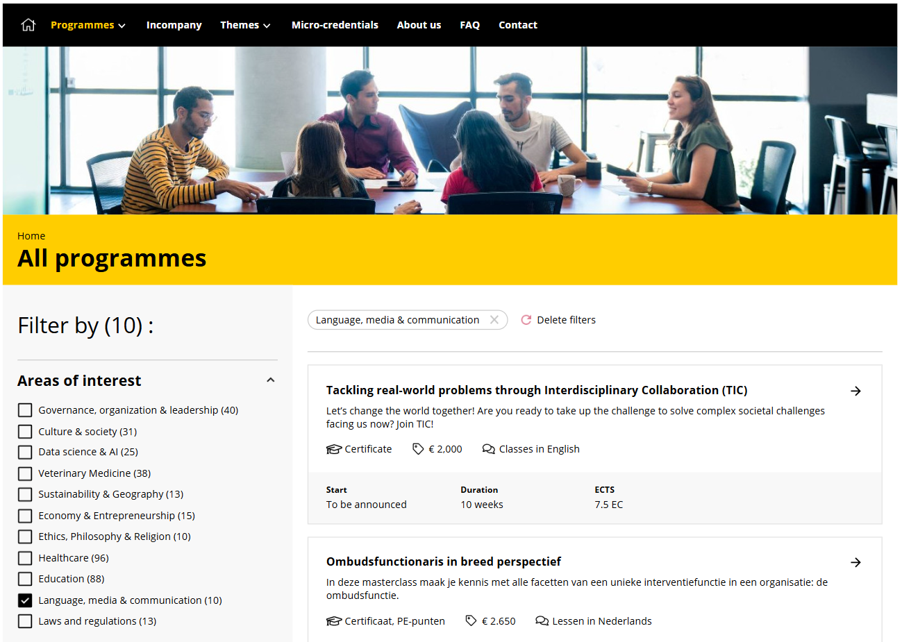
Engage in teaching for professionals, beyond academia
UU Programmes for professionals
https://professionals.uu.nl/en/programmes

Slide 25
12. Engage in teaching for non-professional and lay audiences
Other audiences
How to implement?
Examples
Open education can mean opening up our education to different audiences than UU students. This can be in the form of public engagement
For example:
Primary and secondary education
Citizens
Define you audience: who would benefit from it? Which audiences are you trying to reach?
Which goals would you like to achieve by engaging with this audience?
What would be the most suitable format?
Which resources do you have?
Based on the steps towards a public engagement plan from the Centre for Science and Culture
More “tips and tricks”:
https://www.uu.nl/en/organisation/public-engagement-at-utrecht-university/how-to-engage/tips-tricks
Betweter festival
Utrecht University Museum
Meet the professor
Studium Generale podcast
U talent
(Learning) goals
More information
Raise interest in research
Engage potential users, funders and contributors, and people whose lives may be affected by it
Profit from input from lay audiences by getting their input
Enhance support for and trust in scholarly research
Events organized by the centre for science and culture
U talent

Slide 26
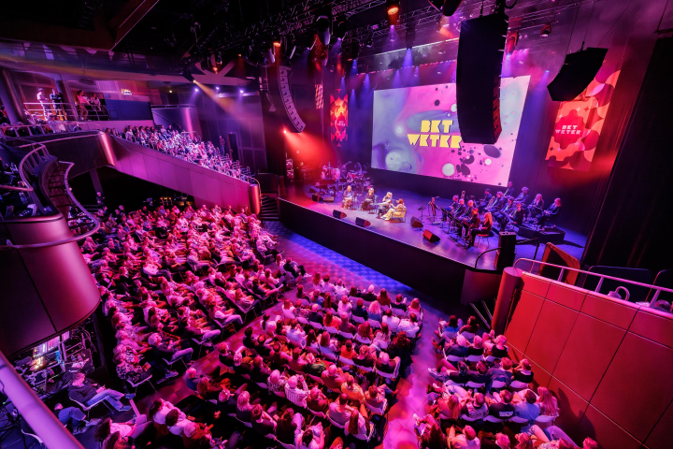
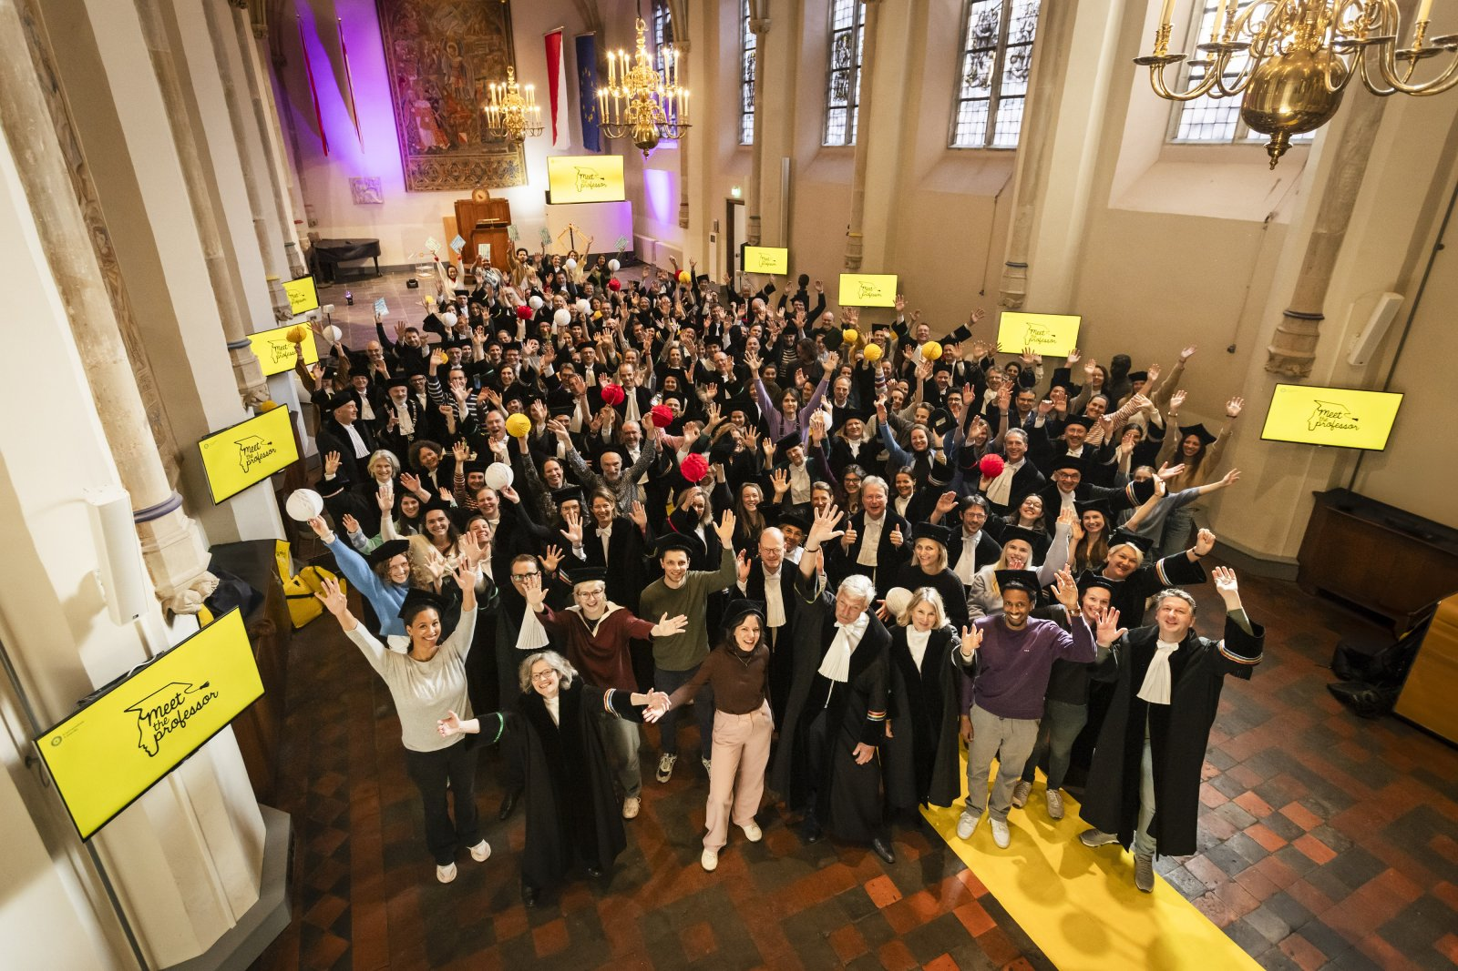
Engage in teaching for non-professional and lay audiences
Betweter festival
Meet the Professor
Researchers, artists and visitors meet each other
Music, live experiments, art and film
Sharing visions and insights on today’s world
UU researchers visit primary schools in Utrecht
The students are introduced to research in an accessible way and can ask questions to the researchers.
Photo: www.betweterfestival.nl
Photo: Lize Kraan, https://www.uu.nl/nieuws/niet-een-maar-twee-onderzoekers-fietsen-naar-de-basisschool

Slide 27
13. Have students work on projects with and for society
Community Engaged Learning (CEL)
How to implement?
Examples
Community Engaged Learning focuses on societal challenges requiring scientific knowledge. Projects are based on mutual benefit: while the community partner’s needs, questions or goals are addressed, students learn through engagement.
Community Engaged Learning activities at the UU contain at least the following components:
An external partner outside higher education is involved in the activity, and has direct interactions with students and instructors.
The activities focus on societal challenges and also consider the underlying elements.
Students reflect on their personals experiences, explore their own value and link them with those of other participants. (Source: uu.nl)
CEL is based on collaboration rather than service. It takes time to build the long-term relationships that benefit a good collaboration.
Students are often not used to collaborating outside academia. Help them to engage respectfully and effectively.
Tackling real world problems (TIC):
https://tic-to-tic.sites.uu.nl/ ​
(Learning) goals
More information
Learning goals for CEL are based on knowledge, skills, values and attitudes (uu.nl). It enables students to apply academic knowledge in real-world contexts while strengthening the societal impact and relevance of education. Students reflect on the role of science in society.
CEL at Utrecht University:
www.uu.nl/en/education/community-engaged-learning/great-examples

Slide 28
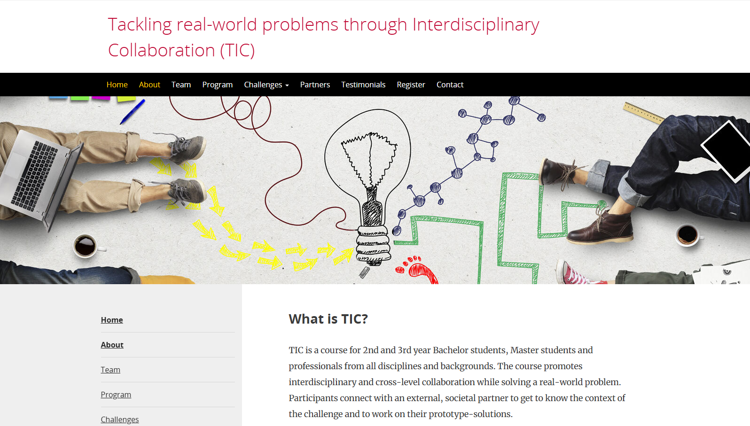
Have students work on projects with and for society
Tackling real-world problems through Interdisciplinary Collaboration (TIC)
https://tic-to-tic.sites.uu.nl/

Slide 29
14. Involve students in creating a course
Design, development, improvement
How to implement?
Examples
Students that are involved in course creation, are not only the recipients of education, instead they co-create. Have you ever thought of their perspectives and experiences on course content, learning activities, materials or assessment?
Students can be involved in course creation through the different phases: design, development and improvement.
University College Student-designed course
(Learning) goals
More information
Improve course relevance, inclusivity and engagement
Improve students’ knowledge on relevant topics, while improving collaborative and design skills
Transparency, engagement and reflection
LibGuide on renewable assignments

Slide 30
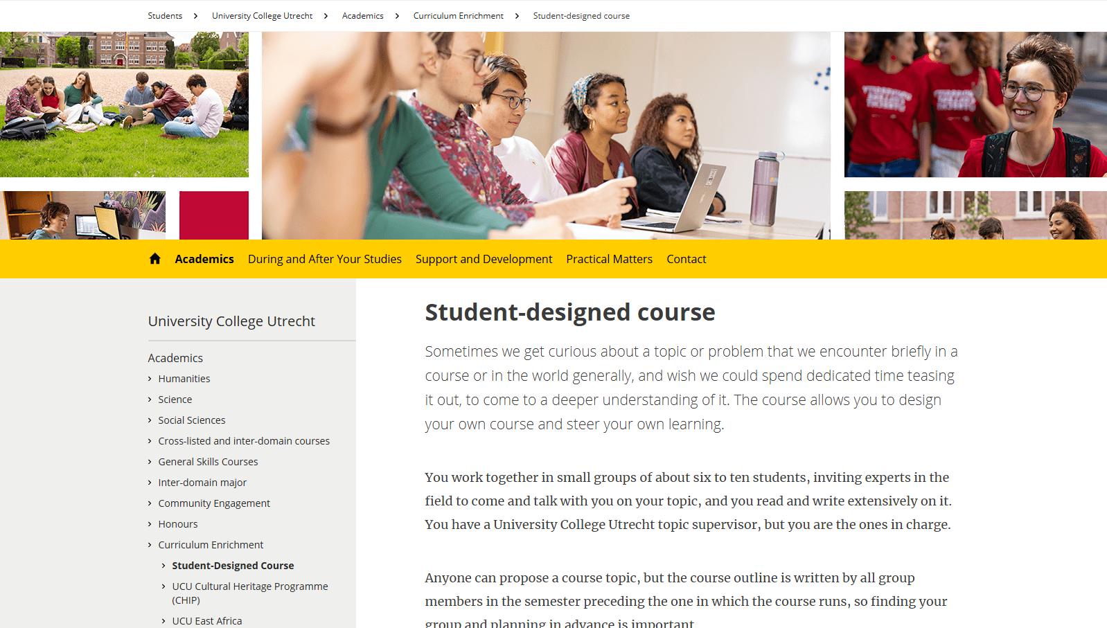
Involve students in creating a course
Student-Designed Course
https://students.uu.nl/en/university-college-utrecht/academics/curriculum-enrichment-options/student-led-honours-seminar

Slide 31
15. Optimising open educational resources for reuse
Reusing OERs
How to implement?
Examples
Sharing your teaching materials as Open Educational Resources (OER) allows for others to reuse it. However, not all shared content can easily be adapted to another educational context. By following certain guidelines, materials become easily adoptable for re-users.
Here's some guidelines that optimise your resource's adaptability. Your resource:
Is shared in an editable format so reusers can easily adapt to their own needs
Provides clear and concise instruction on how to use the teaching materials in class
Provides relevant metadata, e.g. target audience, learning goals, and time needed
Is digitally accessible for users with (visual or hearing) disabilities
Is published in an open format (e.g., .jpeg, .mp3, .odt, .csv) so it can be read by any software (applications).
Refers (through hyperlinks) to openly accessible sources only
Workshop Copyright Basics for Researchers
ShareStats
(Learning) goals
More information
Open educational resources that have been optimised for reuse, aim for low-effort adaptation by reusers. Reuse and therefore the impact of your teaching materials increases when they can be easily adopted.
Edusources
UU Copyright information office
UU Library's OER support page

Slide 32
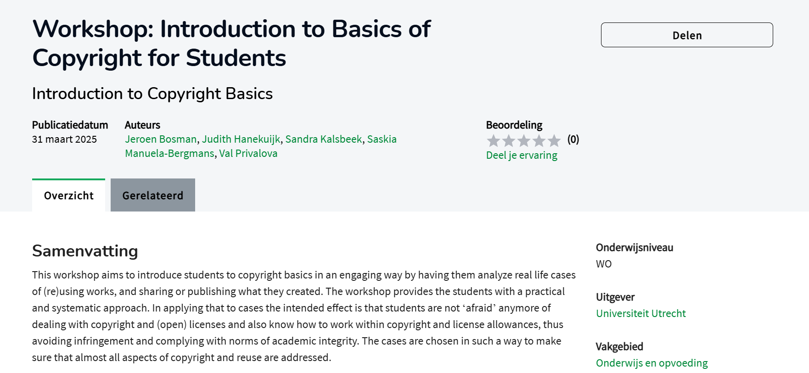
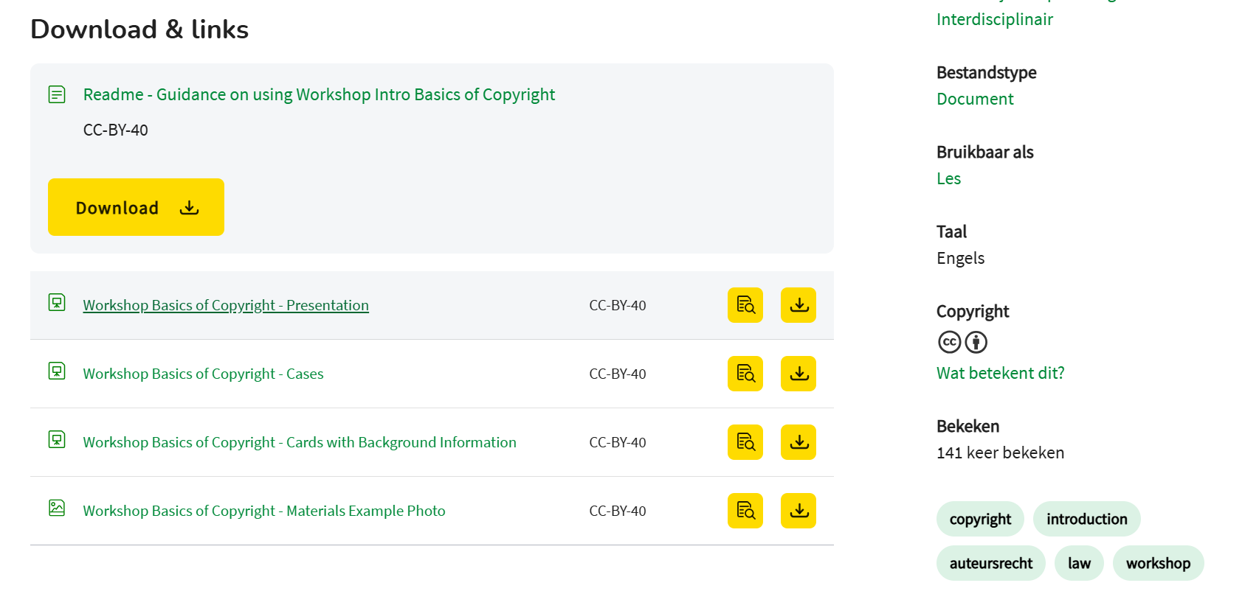
Optimising open educational resources for reuse
Example: Workshop Introduction to Copyright Basics
In this example, reuse of the OER is made accessible in several ways:
Summary
The summary briefly addresses the aim and contents of the material.
Guidance
A separate guidance has been created to explain the material and facilitate reuse.
Metadata
Relevant metadata to find and assess the material (target audience, language, tags)

Slide 33
16. Crediting student work and respecting their copyright
Crediting your students
How to implement?
Examples
As open education can involve more sharing of outcomes and materials online as well as IRL, there are more points in time in which it is important to credit everyone's contribution, including those of students. This includes formal attributions as well as informally mentioning the students' role in whatever was created.
There are a few things students, supervisors, tutors, professors and other can do:
Be aware that students or groups of students have copyright over works they create.
Be aware of any required formal handing over of copyright (in some UU faculties).
Discuss with students how to deal with copyright in advance, especially if any formal publication or open sharing is envisioned. Discuss who will need to be and wants to be listed as (co-)author. When sharing co-authored work discuss and agree on the CC-license with which to share the work.
Even when students granted permission to reuse their unpublished work, always acknowledge their role and work.
In any communication, including presentations and meetings be generous in crediting students' roles and where feasible, safe and within privacy regulation, consider naming individuals as well.
Student blogs on EU law enforcement
Goals
More information
Crediting students' roles, work and creations is not only a matter of decency, but fits student agency and responsibility. It can help them in their career during and after their studies. Also, it is a legal requirement when (re)using student creations over which they have copyrights (unless contractually handed over to the institution)
Copyright Information Office student page

Slide 34
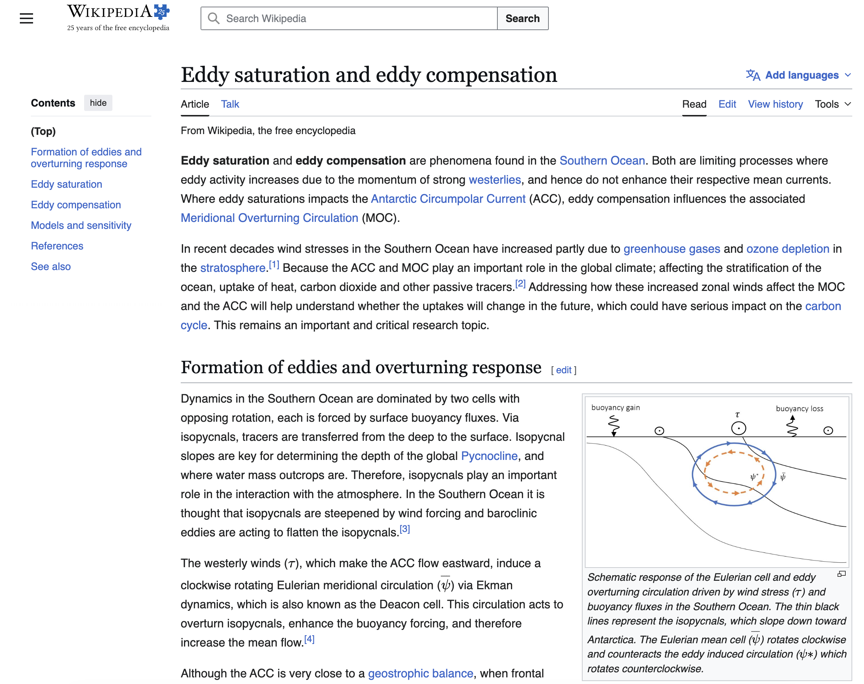
Crediting student work and respecting their copyright
More info: https://www.uu.nl/en/news/wave-of-new-wikipedia-articles-by-oceanography-students

Slide 35
17. Openly share teaching materials
Share materials as OER
How to implement?
Examples
One of the most accessible OE practice is openly publishing educational material as Open Educational Resources (OER), so everyone can easily access teaching materials. These could be: lectures (slides, video), assignments, workshops, manuals, code, instructions to a blog or even entire courses!
(1) Respecting copyright and privacy
It is important to consider possible copyright on photos, videos, information. Remove any personal information before sharing.
(2) Preparing the material for sharing
Add some documentation (e.g. the type of course, level and learning goal it was created for), and if possible some evaluative notions.
(3) Where to publish?
Educational material can be published on freely accessible educational platforms like Edusources.
(4) Licensing
Choose an appropriate Creative Commons license to publish the educational material under: CC-BY or CC-BY-NC. Respect students' rights.
Chef’s Tip:
Multiple materials have already been published on Edusources, such as lectures, works-hops and instructions to educational blogs.
(Learning) goals
More information
Sharing educational material means other teachers can use and build upon existing materials, making the development of material more efficient and effective.
Edusources
CAT: Teaching and learning collection
UU Copyright information office
UU Library's OER support page
Ask the or the library for help on how to share your materials on Edusources!

Slide 36
Openly share teaching materials
Open educational resources on edusources.nl
(Re)use open educational resources
Search for educational materials
Share your own materials
Examples on how to use open resources in practice

Slide 37
18. Encourage student autonomy in their study trajectory
Student autonomy
How to implement?
Examples
Allow students freedom in the way they shape their curriculum, within certain set boundaries.
For example, supporting Bachelor students to do a minor outside of their study curriculum, or an internship outside of the university, with the purpose of trans-disciplinary or community engagement, or career orientation.
Define the graduation criteria
Clear criteria need to be set for the degree. For instance, the amount of disciplinary versus non-disciplinary credits, the levels of the chosen courses, methodology and expected course load.
2. Involved and extensive tutoring
Close supervision of a personal tutor to help students in their choices, offer options and alternatives and guide them to a sensible and coherent degree that matches both student's personal approach to learning as well as the criteria set for the degree. Planning is important to make sure prerequisites for chosen courses are met on time.
3. Scheduling
Curriculum offerings have to be flexible , to allow students to take courses across their career non-consecutively
University College Utrecht offers students extensive autonomy.
Similarly LAS offers a flexible program for students.
(Learning) goals
More information
Autonomy over student's study trajectory, has shown to increase their self-authorship: their capacity to take initiative, set one’s own goals, and take responsibility for one’s direction in learning. This is considered an important learning outcome enabling effective citizenship.
Paper Ria van der Lecq on self-authorship and interdisciplinary learning.
UCU ARR outlining student degree requirements

Slide 38
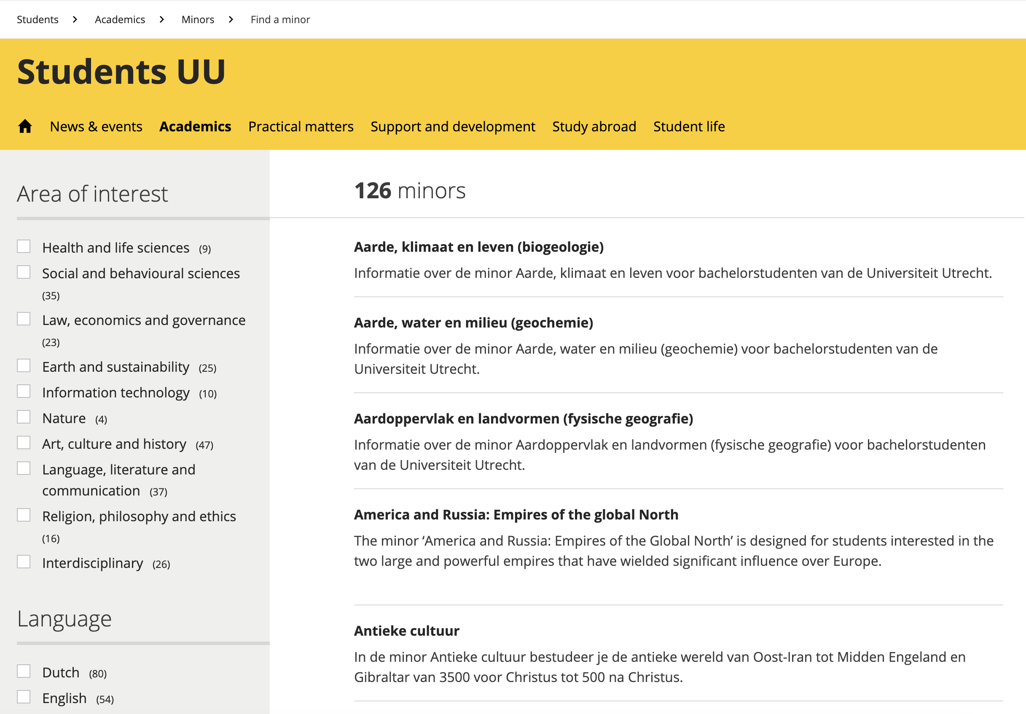
Encourage student autonomy in their study trajectory
Liberal Arts and Sciences (LAS) and Interdisciplinary Social Science
Liberal Arts and Sciences (LAS)
General courses and specialization after first year: create your own study program
Use of portfolio for reflection and to create coherence between the different parts of the curriculum.
Tutor guidance
Interdisciplinary Social Science
General courses and specialization after first year
Students choose one or more study trajectories:
  Social Policy and Public Health
  Youth Development and Social Change
  Migration, Ethnic Relations and Multiculturalism
Minors
Projects to encourage students to take a minor outside their own curriculum
Students can develop complementary skills while exploring a second area of interest

